Slide 1


Unlocking Your Fantasy Basketball Edge
Welcome to the NBA Fantasy Basketball Assistant – your ultimate AI-powered tool for dominating your league. This presentation will walk you through how our application provides unparalleled insights, from predicting team performance to offering personalized recommendations, ensuring you make the most informed decisions.

Slide 2

Section 1
Elevating Your Game with AI
The NBA Fantasy Basketball Assistant is a full-stack AI application engineered for enthusiasts like you. It dives deep into NBA game statistics to arm you with in-depth analysis and actionable insights. Our goal is to transform your decision-making process, making it smarter, faster, and more effective.

Slide 3
Team Performance Analysis
Understanding how teams perform is crucial for fantasy success. Our tool offers two powerful lenses to analyze team dynamics:
1
2
Historical Data Insights
Current Form Tracking
We analyze nine seasons of historical data to uncover patterns and predict future team performances. This long-term view helps identify consistent performers and potential breakouts.
By calculating rolling averages of key statistics over recent games, we determine each team's current form, identifying hot streaks and sudden dips. This allows you to capitalize on real-time trends.

Slide 4
Section 2
Conquering Matchups
The "Matchup Analyzer" is your secret weapon for evaluating team interactions, giving you a distinct advantage in predicting outcomes and identifying crucial player performances.

Slide 5
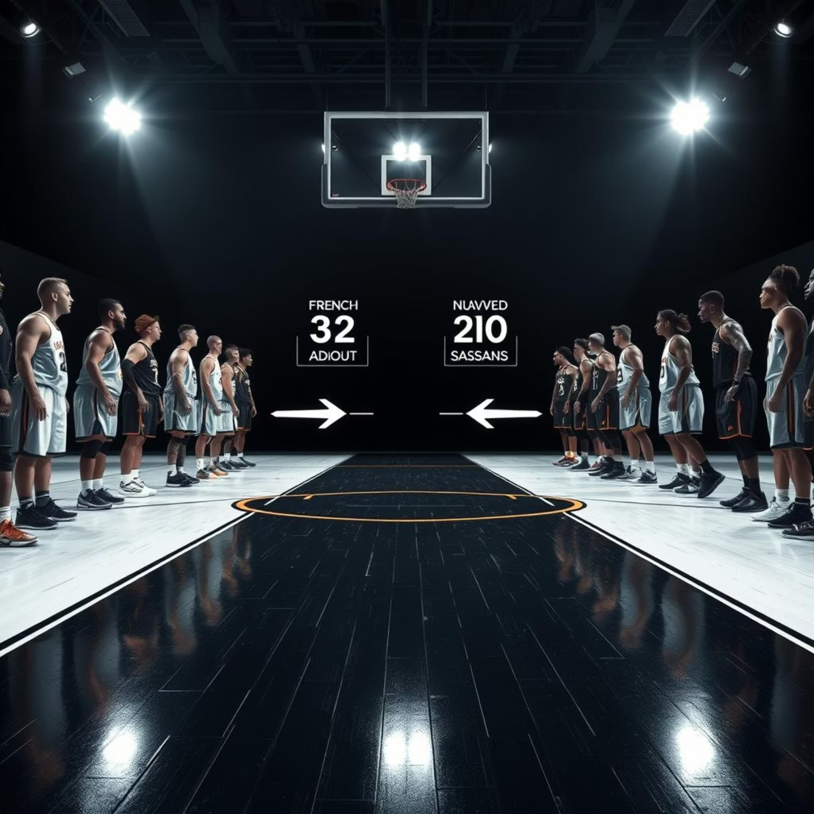
The Matchup Analyzer
The Matchup Analyzer empowers you to predict game outcomes and evaluate matchup strengths and weaknesses, offering a competitive edge in your fantasy league.
Historical Matchup Performance: Delve into past encounters between teams to forecast future outcomes.
Performance Trends Against Specific Opponents: Highlight how teams perform against different opponent archetypes (e.g., defensive powerhouses or high-scoring offenses).

Slide 6
Section 3
Tailored for Your Strategy
Every fantasy player has a unique strategy. Our "Customizable Recommendations" ensure the insights you receive are perfectly aligned with your personal criteria.

Slide 7



Customizable Recommendations
The NBA Fantasy Basketball Assistant doesn't just provide data; it offers personalized recommendations based on your preferences.
Prioritize Your Stats
Tailored Insights
Actionable Advice
Choose which statistics matter most to your fantasy league – whether it's points, rebounds, assists, or defensive stats.
Receive recommendations explicitly crafted to meet your specific needs and maximize your team's potential.
Get clear, actionable advice on who to draft, trade, or bench for optimal performance.

Slide 8
Section 4
The Road Ahead
Our commitment to continuous enhancement means the NBA Fantasy Basketball Assistant will only get better. We're dedicated to evolving the tool with new features and improved accuracy.

Slide 9
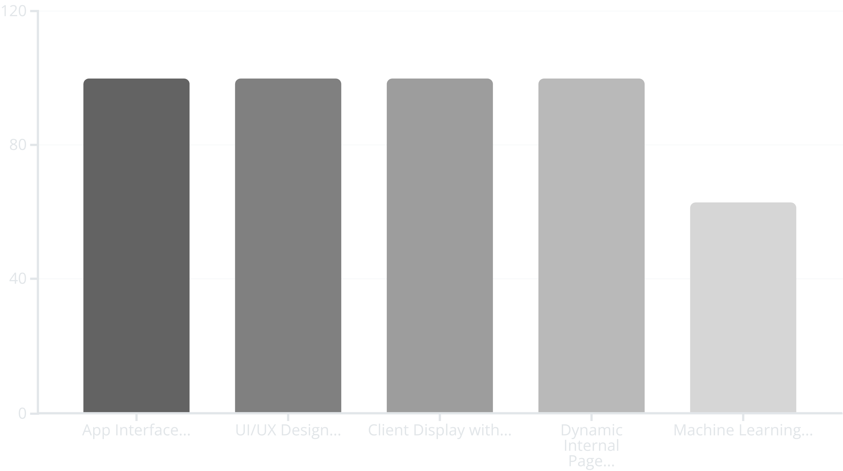
Project Progress & Future Updates
This chart highlights our development progress and outlines areas for future enhancement. We are actively refining our Machine Learning model to boost prediction accuracy and constantly improving the user experience based on your feedback.

Slide 10
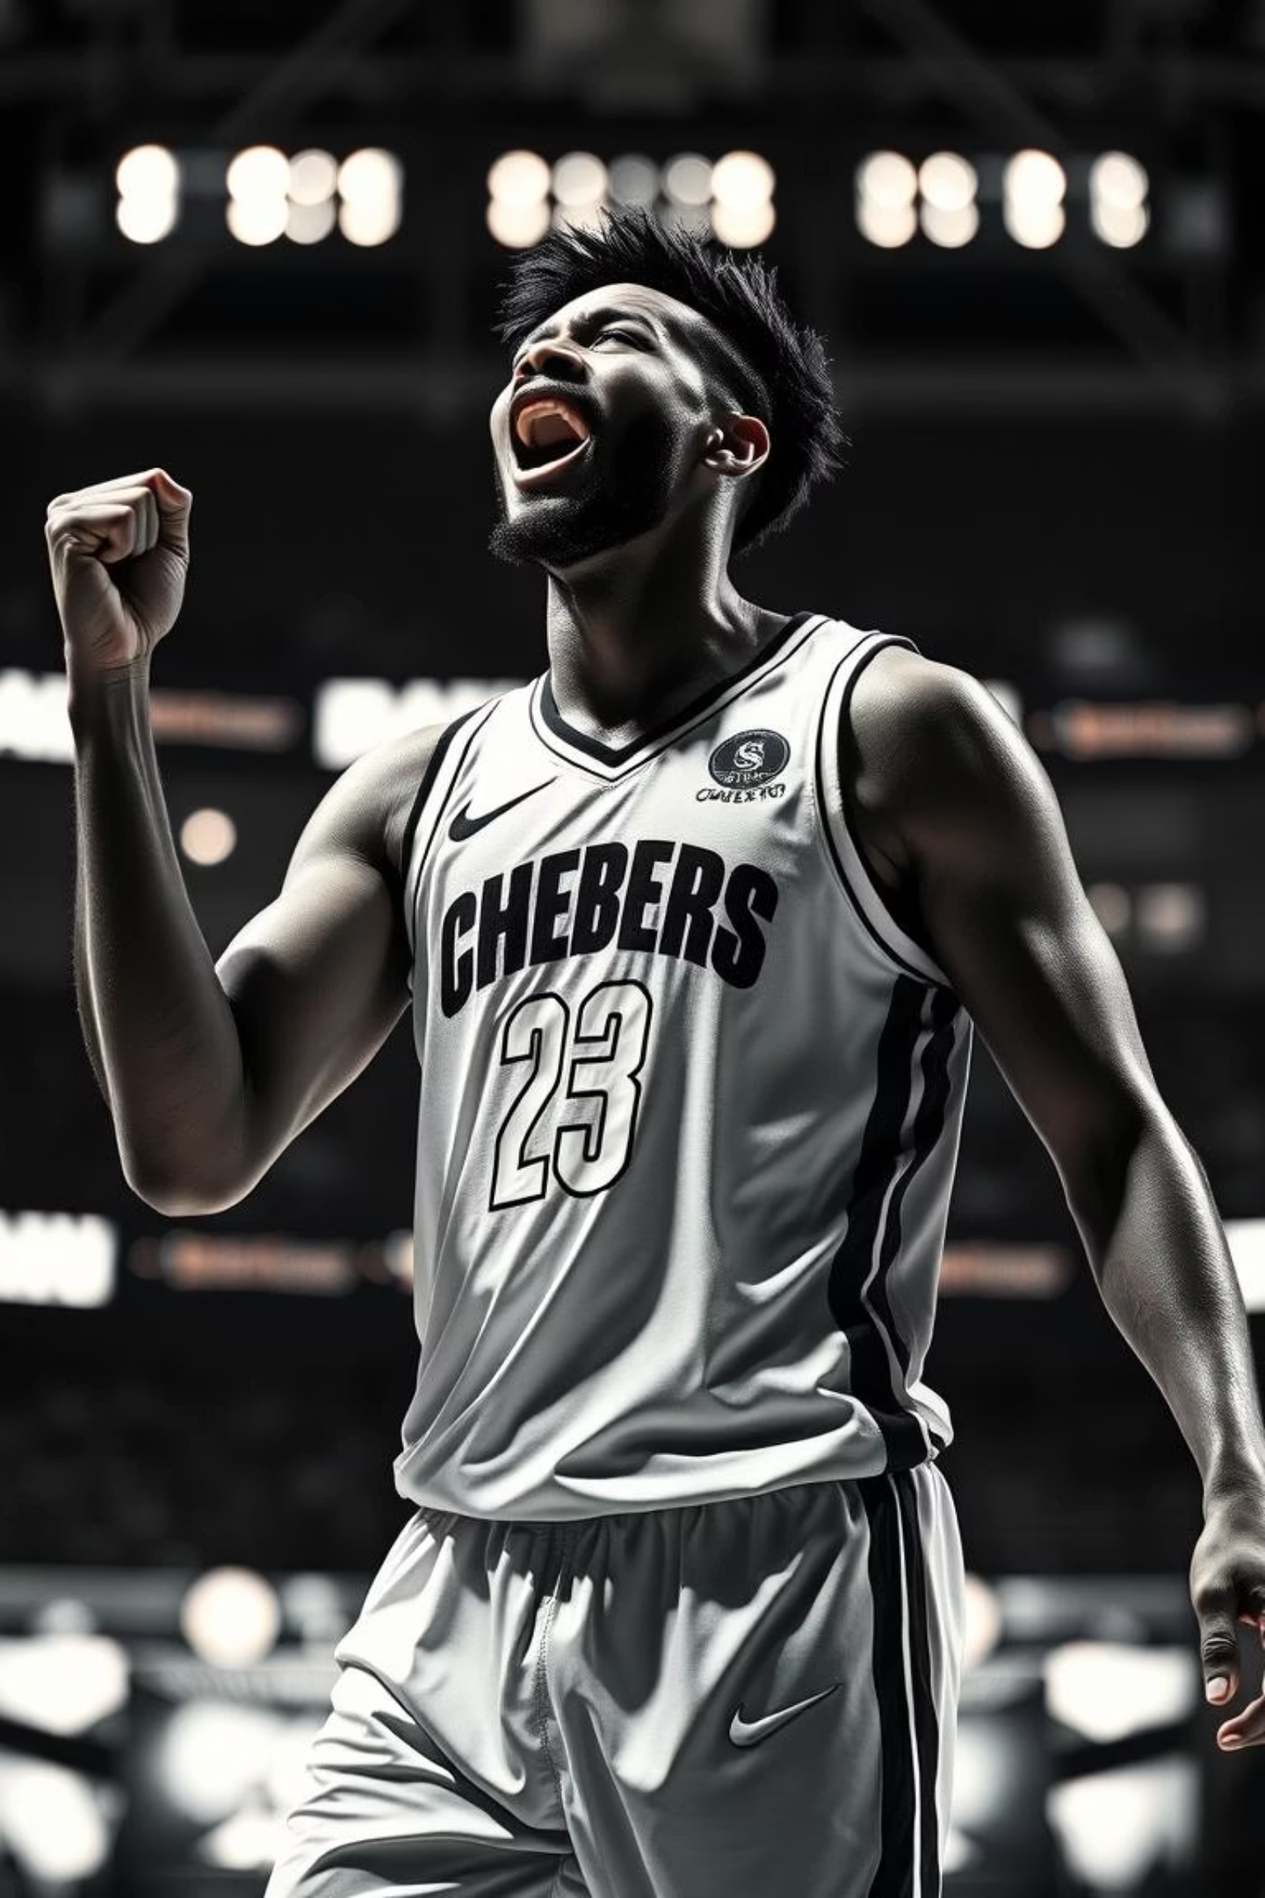
Ready to Dominate Your League?
The NBA Fantasy Basketball Assistant is designed to give you the winning edge. With continuous updates and a focus on actionable insights, you'll be making smarter, more confident fantasy decisions.
Thank you!

